Slide 1

Meeting location
Christ Lutheran Church
510 Luther Drive.Georgetown.TX.78628
512-348-7885 TCFBrushyCreek@hmail.com
(If you have problems finding us call: 512-966-1651)
Our next in-person meeting will be Tuesday, January 10, 2023 at 7:00 p.m.
ZOOM Meeting Inside
Welcome
We, of the Brushy Creek Chapter of The Compassionate Friends, offer you a warm welcome. Our meetings are on the second Tuesday of each month at 7pm. The Compassionate Friends is a mutual assistance, self-help organization offering friendship, understanding and hope to bereaved families. Anyone who has experienced the death of a child at any time, of any age, from any cause is welcome. Our meetings give an opportunity to families to talk about their feelings as they go through the grieving process. The purpose of this support group is not the cause of death but rather to focus on being a bereaved parent, sibling or grandparent, along with the feelings and issues that evolve around the death experience of a child. There is no religious affiliation. There are no membership dues.
Information Regarding Our Meetings
This is YOUR group and we are here to support each other. Everyone in the room has walked the path you are on now. We hope you will find our meetings and newsletters to be a comfort and a place where you find hope.
To Our New Members
We recognize that it takes great courage to come to the first meeting, whether you are a bereaved parent, sibling or grandparent of one month or many years. Please don’t be afraid to come to a meeting. You are welcome to bring a friend or relative for moral support if you wish. Nothing is asked of you. You will find that it is alright to cry and to laugh, to share how you feel or just listen. You do not have to talk at a meeting if you do not want to. We welcome your participation, but it is not a requirement. To be fair to yourself, please consider attending at least three meetings before you decide whether TCF is right for you.
The Mission of The Compassionate Friends
When a child dies, at any age, the family suffers intense pain and may feel hopeless and isolated.
The Compassionate Friends provides highly personal comfort, hope, and support to every family experiencing the death of a son or a daughter, a brother or a sister, or a grandchild, and helps others better assist the grieving family.
This Month’s Topic
.
Things I Have Learned About Myself Since You’ve Been Gone – The death of a loved one invites you to get to know yourself in a new way. Grief can lead you to realize, fortify or rekindle values you deeply identify with. It can also illuminate your strengths, areas for growth and a direction for the future.

Slide 2


January Birthdays
Memories
Of
Melissa
We celebrate Melissa’s birthday going to her favorite restaurant Olive Garden, I also go to H‑E‑B on the 13th to pay for a birthday cake someone has ordered in her honor. Everyday we talk about Melissa, but her birthday is one we really talk about the crazy things she would do and say. She was loved by so many.
Ruby Neave
Melissa’s Mom

Slide 3


January Angel Dates
Please let us know if you would like to contribute a memory of your loved ones, birthday, anniversary of death or any memories, stories or pictures for your newsletter.

Slide 4
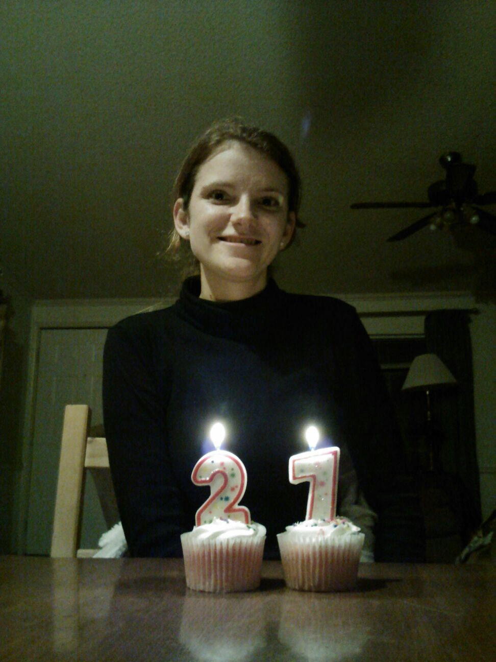
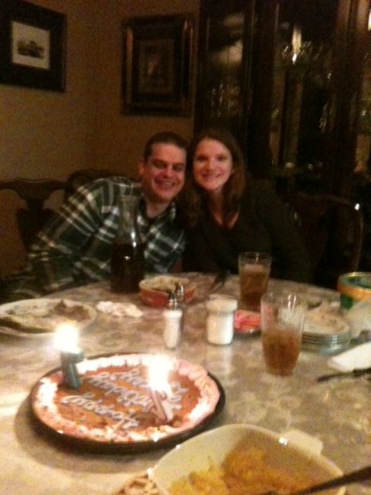
Memories
of
Lacey
Maaaaahhhm” That’s the way Lacey would say “Mom” if she was either aggravated with me or teasing me. Short “Mom” with a sparkle in her voice, was saved for some exciting news. The month just before Lacey’s 28th birthday, I got a phone call with the “short version” Mom. She called to tell me she had just become engaged to her boyfriend, Cole. December 2012 was full of “short version Mom”conversations. After becoming engaged, Lacey was hired at Annie Purl Elementary - the place she had longed to be teaching her entire career. Then there was the announcement that her fiancé had plans to open his own business. The news that they were moving to a country home outside of Georgetown. Certainly life was so full of beautiful surprises and plans.
Lacey’s last earthly birthday was 1/25/2013 when she became 28 years old. She gained her heavenly birthday on 3/31/13. Cole always made a big deal for Lacey’s birthday - usually with a pepperoni pizza he made himself!
This January would have been Lacey’s 38th birthday. So many memories of her birthday, from the very day when she came into the world with a Cyndi Lauper haircut (from the doctor’s c-section blade coming a little too close to her tiny head) through all of the years of Barbie dolls, sleepovers, surprise college parties.
The question is: since January 2014, how do we celebrate her birthday? We be. We be and feel what we need to. Sometimes we “do” on that day. My husband always takes a balloon bouquet to her at the spot she shares with Cole. Lacey’s sister always takes a shot of tequila. Every year has been different for me. The first year I took a “GAP” bag to their “spot” in the cemetery, because she loved shopping and because that was the last thing we did together - shopping for an outfit for their engagement pictures. Sometimes I just stay home to look at pictures, read her writings and poems, reread the cards people have sent. One year Lacey’s Kindergarten friend and her mom took me to brunch. Often, Lacey’s college roommate will take the day off and we hang out. Always there are calls and hugs from Cole’s family and our family. Early on were cards from so many. There are still a few who remember with unfailing notes, FB posts, and love. TCF is a comfort to talk about her and be with other’s who share their journey’s of grief.
Penny Leone
Lacey’s Mom

Slide 5


TCF BrushyCreek is inviting you to a scheduled Zoom on Jan 26, 2023 07:00 PM Central Time (US and Canada)
Join Zoom Meeting
https://us02web.zoom.us/j/85630439417?pwd=VmVBVFpqVTgyN0Y5UnNFUi8yT3BGdz09
Meeting ID: 856 3043 9417
Passcode: TCF-Jan
For Phone use ONLY: One tap mobile
+13462487799,,85630439417#,,,,*5005285# US (Houston)
Dial by your location
+1 346 248 7799 US (Houston)
Meeting ID: 856 3043 9417
Passcode: 5005285. (For phone only)
Find your local number: https://us02web.zoom.us/u/kfJK7d7vS

Slide 6



Nathan Peterson shares how music has helped him cope with his grief and make a positive impact on the world. Hear Nathan share one of his beautifully written, heartfelt songs of comfort and why supporting The Compassionate Friends matters to him.
https://youtu.be/CEd4y7VdN-E
Nathan supports The Compassionate Friends because of the difference TCF made in his and his family's life. Please join Nathan in giving a gift to support all our grieving families during this season when our grief can feel extra painful.
Thank you to everyone that participated in the Worldwide Candle Lighting either with us or at your home.
My sincere apology to Tina and Mike Lucas for my mistake on their daughter’s December Angel date information.
I am sorry,
Shelley

Slide 7


The Compassionate Friends Credo
We need not walk alone. We are The Compassionate Friends. We reach out to each other with love, with understanding, and with hope.
The children we mourn have died at all ages and from many different causes but our love for them unites us. Your pain becomes my pain, just as your hope becomes my hope.
We come together from all walks of life, from many different circumstances. We are a unique family because we represent many races, creeds, and relationships. We are young, and we are old. Some of us are far along in our grief, but others still feel a grief so fresh and intensely painful that they feel helpless and see no hope.
Some of us have found our faith to be a source of strength, while some of us are struggling to find answers. Some of us are angry, filled with guilt or in deep depression, while others radiate an inner peace. But whatever pain we bring to this gathering of The Compassionate Friends, it is pain we will share, just as we share with each other our love for the children who have died.
TCF Brushy Creek
Steering Committee
Co-Leaders:
Committee Members:
Robin Cassens
Caty Craig, Sibling Rep.
Stephanie Thomsen, Sibling Rep.
Mary Delaney
Vickey Harrison
Penny Leone
Rebecca Burgman-Advisory
TCF National Office Information:
The Compassionate Friends
PO Box 3696
Oak Brook, IL 60522 (or)
900 Jorie Blvd. Suite 78
Oak Brook, IL 60523
Phone (630) 990-0010
Toll-Free (877) 969-0010
www.compassionatefriends.org
Email Address:
TCFBrushyCreek@gmail.com
The Compassionate Friends of Brushy Creek

