Slide 1



Meeting location
Christ Lutheran Church
510 Luther Drive.Georgetown.TX.78628
512-348-7885 TCFBrushyCreek@hmail.com
(If you have problems finding us call: 512-966-1651)
Our next in-person meeting will be Tuesday, November 8, 2022 at 7:00 p.m.
ZOOM Meeting Information to follow
Welcome
We, of the Brushy Creek Chapter of The Compassionate Friends, offer you a warm welcome. Our meetings are on the second Tuesday of each month at 7pm. The Compassionate Friends is a mutual assistance, self-help organization offering friendship, understanding and hope to bereaved families. Anyone who has experienced the death of a child at any time, of any age, from any cause is welcome. Our meetings give an opportunity to families to talk about their feelings as they go through the grieving process. The purpose of this support group is not the cause of death but rather to focus on being a bereaved parent, sibling or grandparent, along with the feelings and issues that evolve around the death experience of a child. There is no religious affiliation. There are no membership dues.
The Mission of
The Compassionate Friends:
When a child dies, at any age, the family suffers intense pain and may feel hopeless and isolated.
The Compassionate Friends provides highly personal comfort, hope, and support to every family experiencing the death of a son or a daughter, a brother or a sister, or a grandchild, and helps others better assist the grieving family.
TO OUR NEW MEMBERS:
We recognize that it takes great courage to come to the first meeting, whether you are a bereaved parent, sibling or grandparent of one month or many years. Please don’t be afraid to come to a meeting. You are welcome to bring a friend or relative for moral support if you wish. Nothing is asked of you. You will find that it is alright to cry and to laugh, to share how you feel or just listen. You do not have to talk at a meeting if you do not want to. We welcome your participation, but it is not a requirement. To be fair to yourself, please consider attending at least three meetings before you decide whether TCF is right for you.
This Month’s Topic
Getting Through The Holidays
.
Information Regarding Our Meetings
This is YOUR group and we are here to support each other. Everyone in the room has walked the path you are on now. We hope you will find our meetings and newsletters to be a comfort and a place where you find hope.

Slide 2
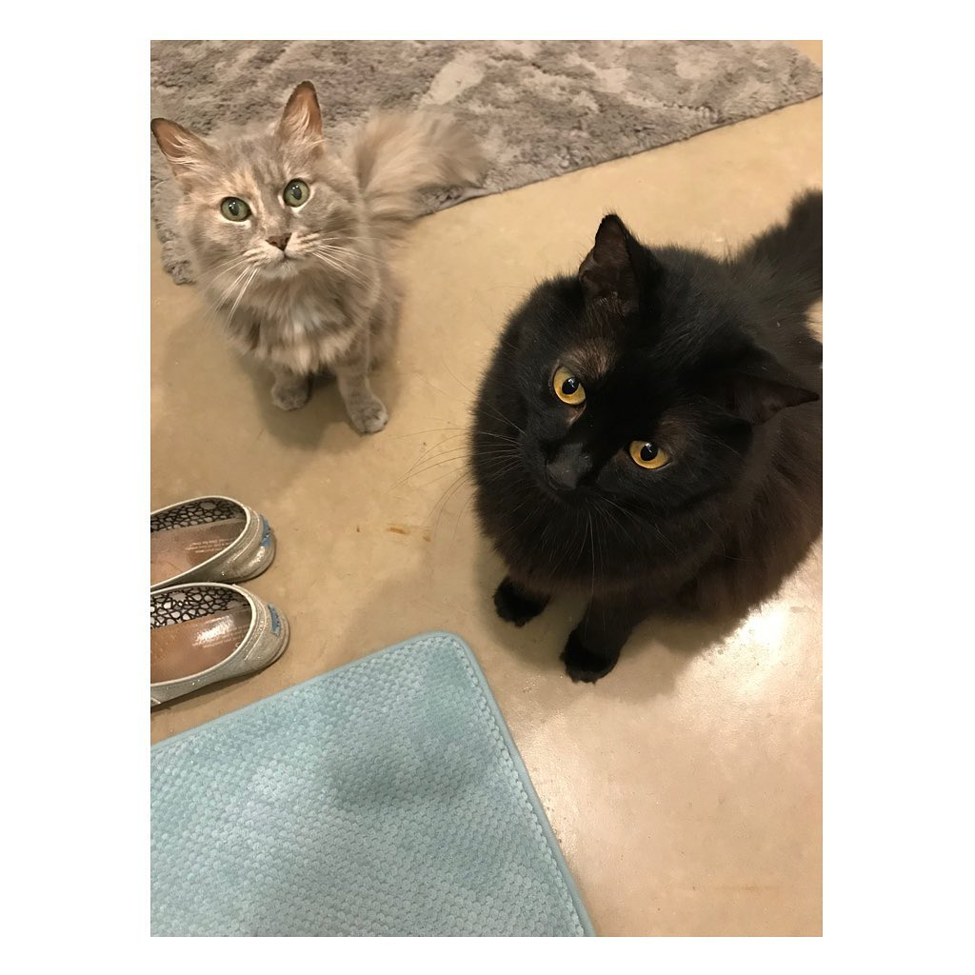
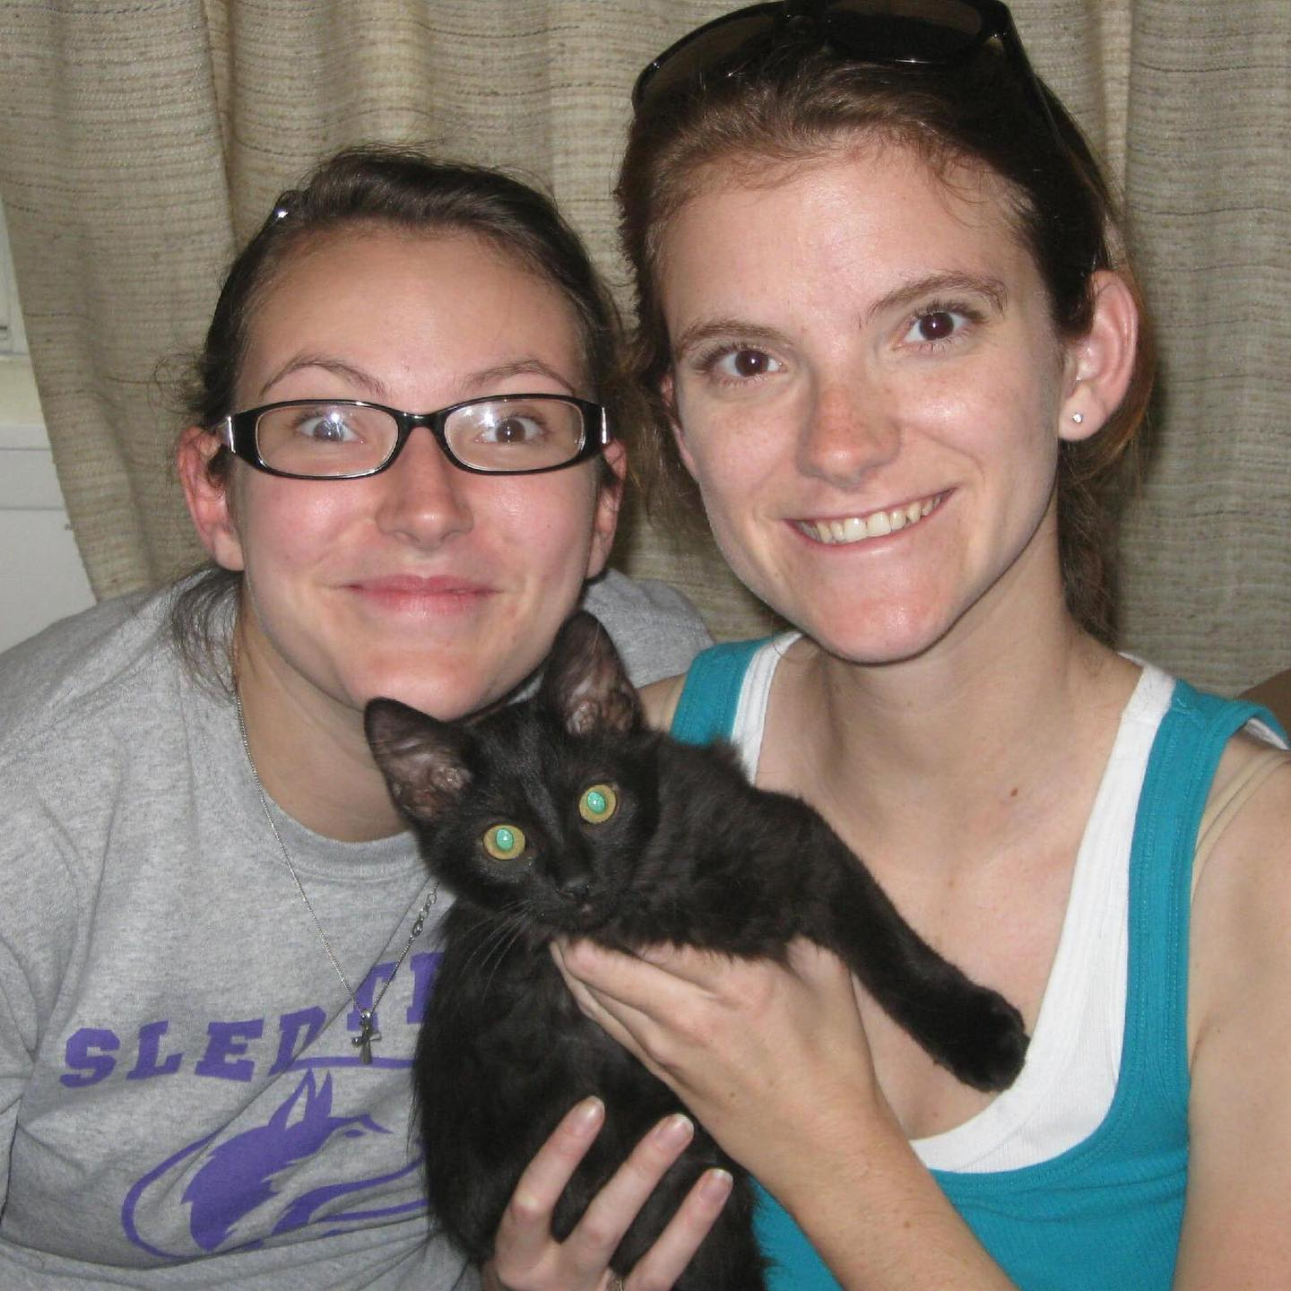
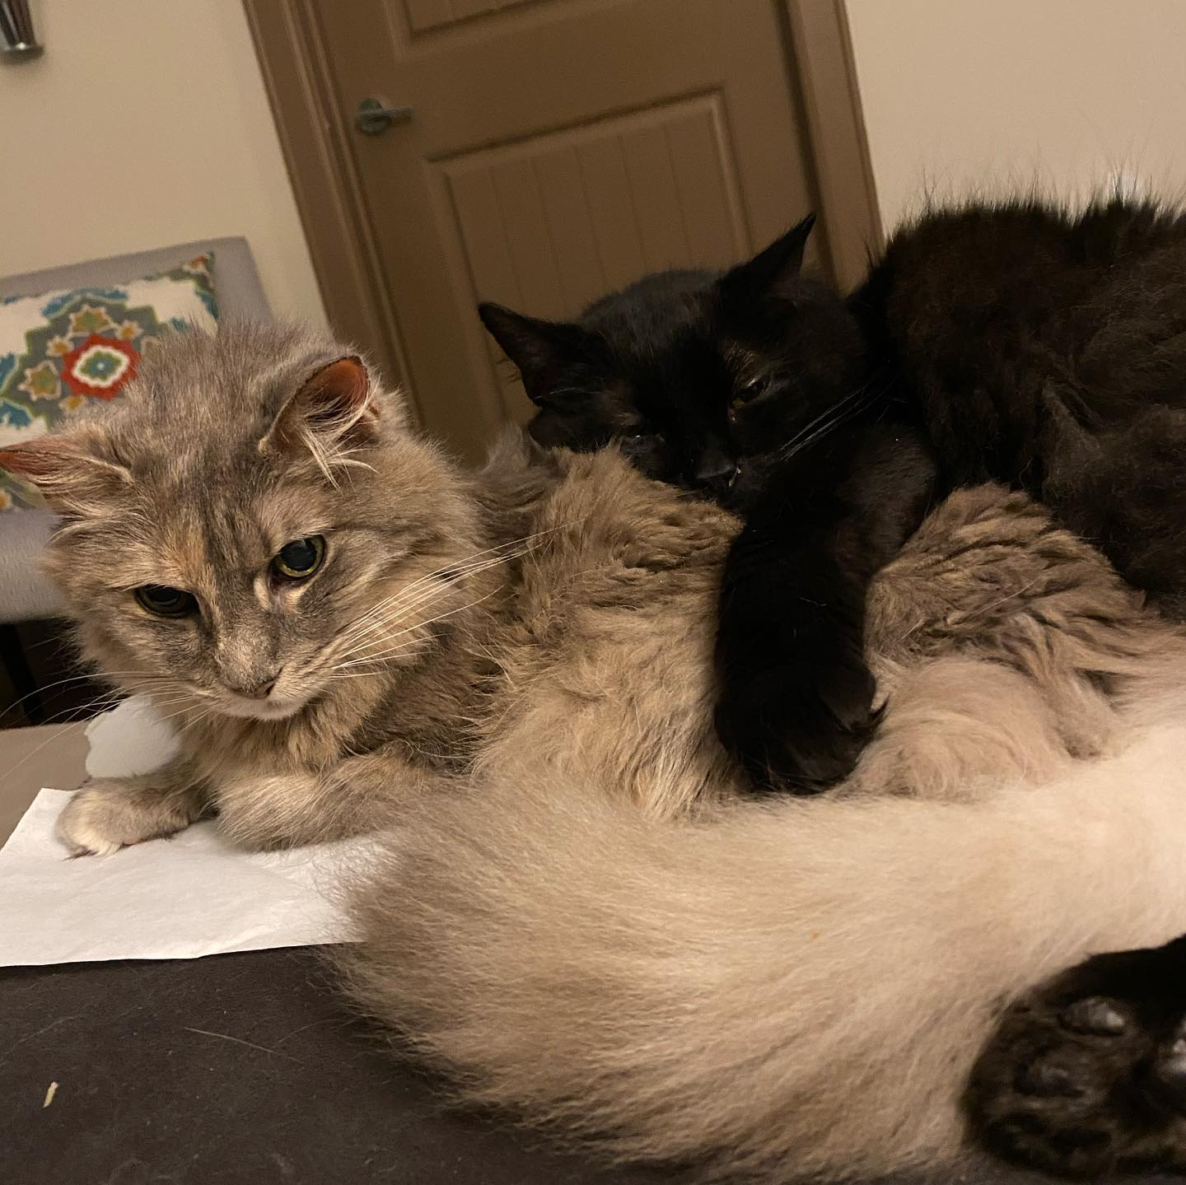
Sisters Always
In January 2013, I decided I was going to adopt a dog. I looked on PetFinder, took quizzes to see which breed would be my best match, fantasized about going on walks and car rides and what I was going to name them. Well, the following March my sister, Lacey, died leaving behind two cats, Barbie and Frank. All of the sudden I became a cat mom with zero experience being solely responsible for pets. You know the saying about life giving you lemons? Yeah, well life gave me cats.
There were some rough patches in the beginning. I had no idea what I was doing with them. I felt Lacey’s absence a lot during that time and wished I could call her for her advice and tell her stories about the funny things they’d do. I would tell them for the first few years that I missed their mom too and that we’d get through it together. And we did. We got through four apartment moves, a number of ailments and eventually Frank and I made it through after Barbie died two years ago.
Unfortunately Frank was diagnosed with intestinal cancer back in July of this year. It was the same thing Barbie had - which we were able to maintain and treat for nine months after her diagnosis. However Frank didn’t respond to the treatment and my vet and I made the decision to put him down last Friday. Grief is hard to explain. Lacey will have been gone for ten years next March, and yet Frank’s passing somehow felt like she died all over again. He was what felt like the last living connection to her. It’s been tough. It’s the end of an era.
Most of my friends aren’t cat people, but they were Frank people. His plumpness and affinity for belly rubs were hard to resist. He had chronic sinus issues and would sneeze on everything, all the time. He also loved cuddles and soaking up patio time.
Life gave me cats and I made a family ❤️
Christina Unger
Sister of Lacey Unger

Slide 3
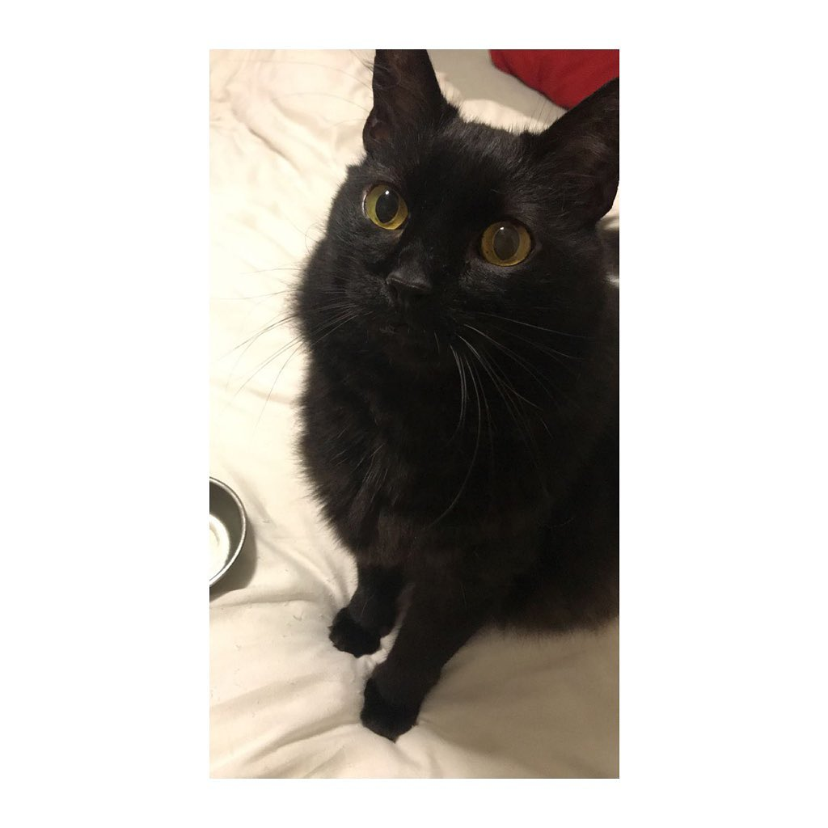
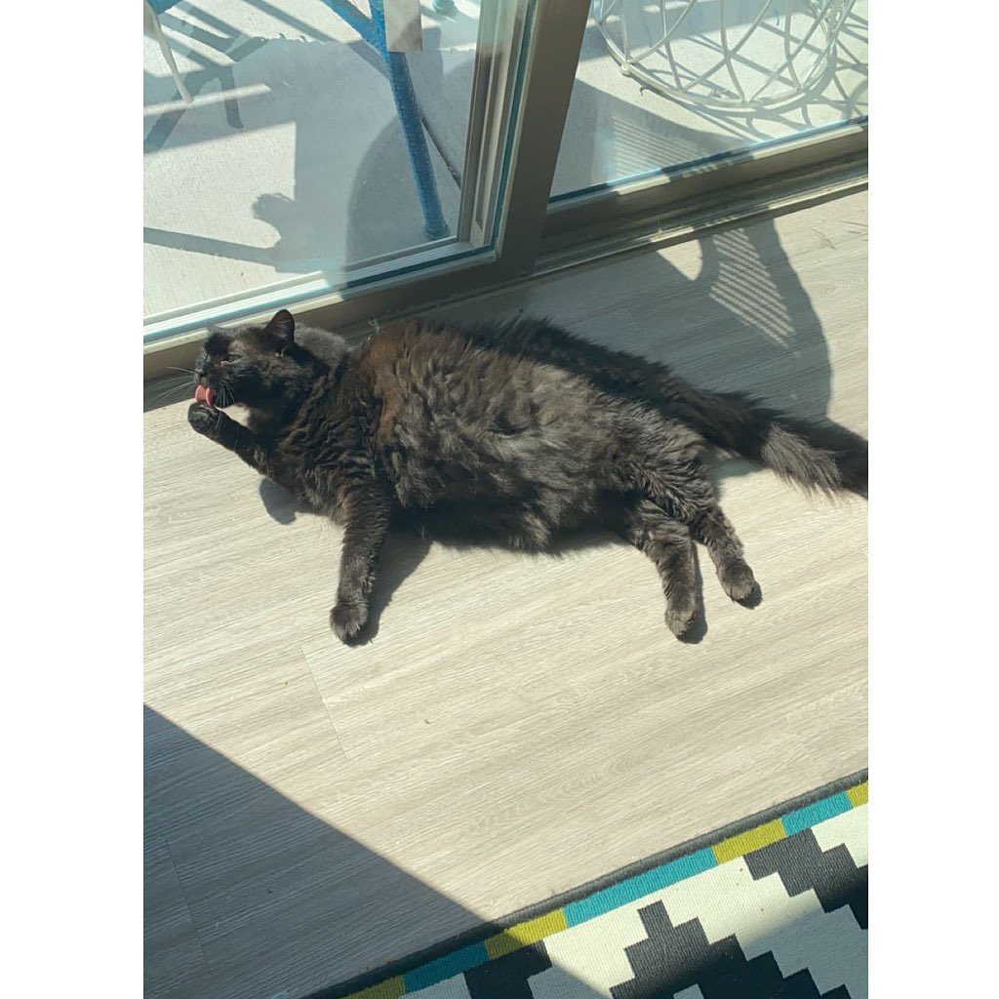
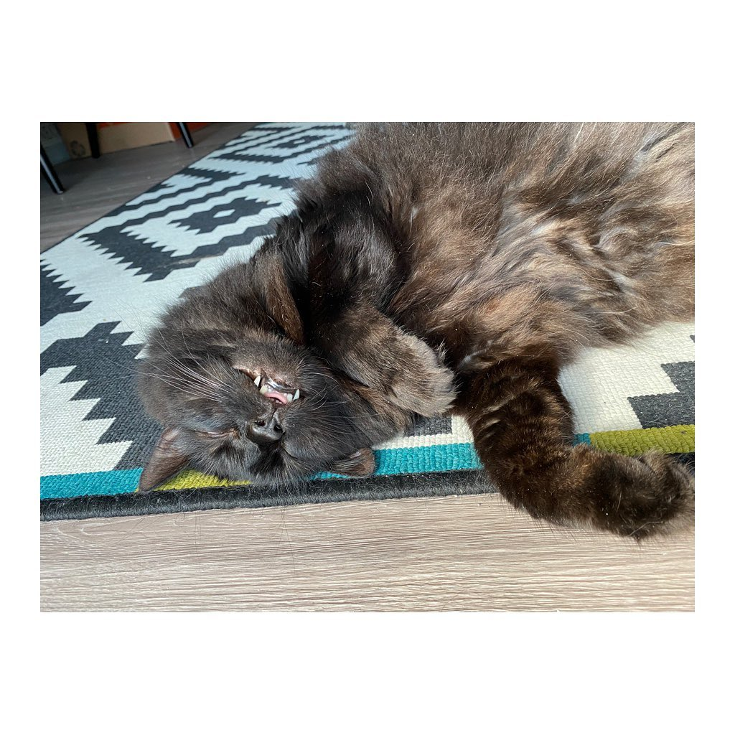
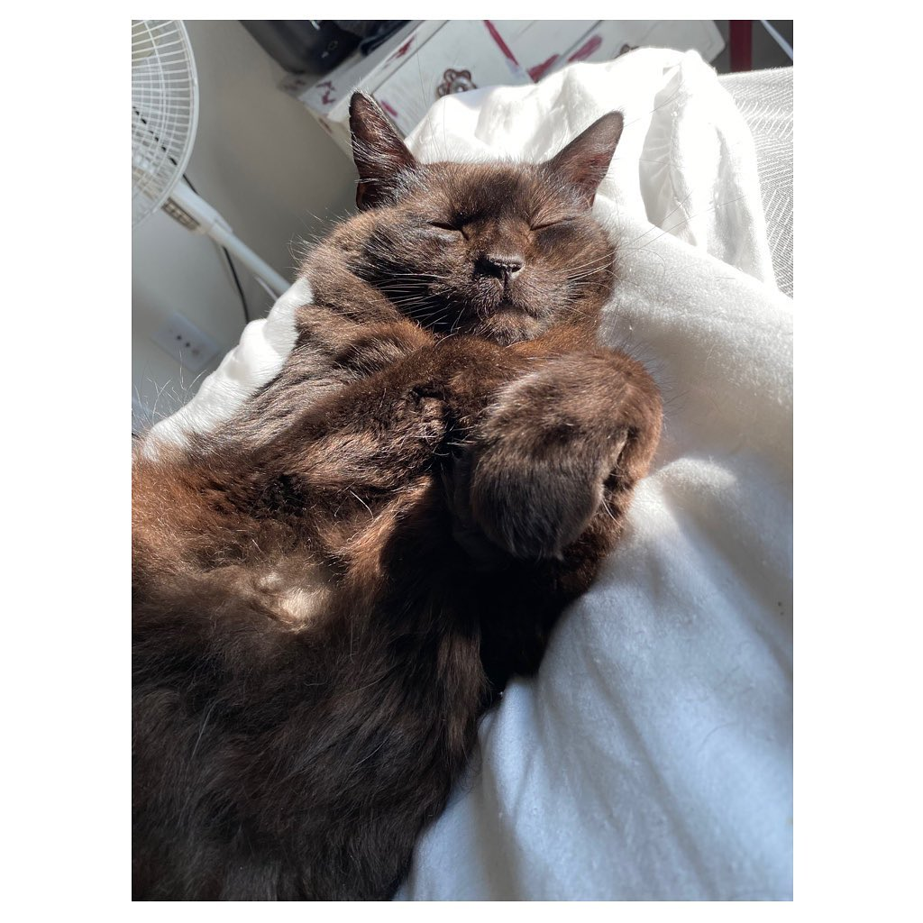
Barbie
& Frank

Slide 4



World Candle Lighting - Save Sunday, December 11, 6:30-8pm for the TCF World Candle Lighting Event. We will have no "regular Tuesday/Thursday" meetings in December. The WCL is open to all families and friends for this unique opportunity to light a candle for our loved ones and participate in the wave of light around the world on the second Sunday of December. Invite everyone to participate in this free and very moving event.
Tell your story: Have you thought that your story of your grief journey could be helpful to others? Would you share your thoughts, stories, pictures, poems with this newsletter? If you find something that helped you.... a book, an event, an activity, a blog? Throughout this coming year, consider sending a contribution .

Slide 5

Please join us on November 19, 2022, for a Full Day Virtual Grief Gathering! TCF will be having an online event that offers an opportunity for bereaved parents, siblings, and grandparents to come together virtually to receive care, support, and information. This special gathering will include live, interactive workshops across a variety of grief topics plus recordings of our Keynote Presentations from TCF's 45th National Conference that was held this past summer. In addition to the main sessions, over 15 workshops will be offered. Help us spread the word for this virtual grief gathering by passing on this information to your chapter members so that they have an opportunity to attend. All sessions will be recorded, and attendees will have access to the recordings for 90 days after the event.
EARLY BIRD rate: $95.00 - Ends on October 19th
Rate after October 19, 2022 - $115.00

Slide 6

https://web.cvent.com/event/a8994249-77f0-4e92-9efc-3415af66c514/summary?bbejrid=-1806115781&bbemailid=43226410&bblinkid=264160384
WORKSHOPS
The Gifts of Grief presented by Donna Goodrich
The Emerging You presented by Nate McClendon
My Bereavement Pain Has Dulled, Am I Ok? presented by Dennis Gravelle
Healing When Faith is Not an Option presented by Peggi Johnson
Struggling to Reclaim My Faith presented by Dennis Apple
After Death Communication Techniques to Engage Your Loved One presented by Rebecca Austill-Clausen
Surviving Your First Year presented by Lisa Ellison
Getting a Grip on Grief presented by Maggie Bauer
Help! I’m Worried about My Teen or Young Adult Child presented by Dr. Gloria Horsley and Dr. Heidi Horsley
Life Derailed: Panel on the Loss of Only/All Children presented by Pam Smith, Darle Heck, Rebecca Murphy, and Beverly Mott
Shame, Grief, and Love: Life Before and After a Substance-Related Death presented by Laura Hartless
Coping with Suicide presented by Dr. Bob Baugher
Grandparent Grief presented by Barb Smith
Shifting Family Dynamics presented by Zander Sprague
Why Am I Still Crazy After All These Years? presented by Cindy Tart and Jordon Ferber
The Issues are in Your Tissues presented by Jason Wendroff-Rawnicki
When Grandparents Lose a Grandchild: Realities of OUT of Sequence Loss presented by David Dieterle
Panel: Loss of An Only Child/All Your Children for Aging Parents with No Legacy presented by Paula Neidorf, Jean Campbell, Ann Rose, Bohdanna Witiuk, and Jackie Glawe
Full Day Virtual Grief Gathering of The Compassionate Friends
November 19, 2022 - 11:30 am - 6:30 pm EST

Slide 7


The Compassionate Friends Credo
We need not walk alone. We are The Compassionate Friends. We reach out to each other with love, with understanding, and with hope.
The children we mourn have died at all ages and from many different causes but our love for them unites us. Your pain becomes my pain, just as your hope becomes my hope.
We come together from all walks of life, from many different circumstances. We are a unique family because we represent many races, creeds, and relationships. We are young, and we are old. Some of us are far along in our grief, but others still feel a grief so fresh and intensely painful that they feel helpless and see no hope.
Some of us have found our faith to be a source of strength, while some of us are struggling to find answers. Some of us are angry, filled with guilt or in deep depression, while others radiate an inner peace. But whatever pain we bring to this gathering of The Compassionate Friends, it is pain we will share, just as we share with each other our love for the children who have died.
TCF Brushy Creek
Steering Committee
Co-Leaders:
Committee Members:
Robin Cassens
Caty Craig, Sibling Rep.
Stephanie Thomsen, Sibling Rep.
Mary Delaney
Vickey Harrison
Penny Leone
Rebecca Burgman-Advisory
Shelley Ransom-Newsletter
TCF National Office Information:
The Compassionate Friends
PO Box 3696
Oak Brook, IL 60522 (or)
900 Jorie Blvd. Suite 78
Oak Brook, IL 60523
Phone (630) 990-0010
Toll-Free (877) 969-0010
www.compassionatefriends.org
Email Address:
TCFBrushyCreek@gmail.com
The Compassionate Friends of Brushy Creek

