Slide 1


Meeting location
Christ Lutheran Church
510 Luther Drive.Georgetown.TX.78628
512-348-7885 TCFBrushyCreek@hmail.com
(If you have problems finding us call: 512-966-1651)
Our next in-person meeting will be Tuesday, October 11, 2022 at 7:00 p.m.
ZOOM Meeting Information to follow
Welcome
We, of the Brushy Creek Chapter of The Compassionate Friends, offer you a warm welcome. Our meetings are on the second Tuesday of each month at 7pm. The Compassionate Friends is a mutual assistance, self-help organization offering friendship, understanding and hope to bereaved families. Anyone who has experienced the death of a child at any time, of any age, from any cause is welcome. Our meetings give an opportunity to families to talk about their feelings as they go through the grieving process. The purpose of this support group is not the cause of death but rather to focus on being a bereaved parent, sibling or grandparent, along with the feelings and issues that evolve around the death experience of a child. There is no religious affiliation. There are no membership dues.
The Mission of
The Compassionate Friends:
When a child dies, at any age, the family suffers intense pain and may feel hopeless and isolated.
The Compassionate Friends provides highly personal comfort, hope, and support to every family experiencing the death of a son or a daughter, a brother or a sister, or a grandchild, and helps others better assist the grieving family.
TO OUR NEW MEMBERS:
We recognize that it takes great courage to come to the first meeting, whether you are a bereaved parent, sibling or grandparent of one month or many years. Please don’t be afraid to come to a meeting. You are welcome to bring a friend or relative for moral support if you wish. Nothing is asked of you. You will find that it is alright to cry and to laugh, to share how you feel or just listen. You do not have to talk at a meeting if you do not want to. We welcome your participation, but it is not a requirement. To be fair to yourself, please consider attending at least three meetings before you decide whether TCF is right for you.
This Month’s Topic
Grief and Your Relationships
GRIEF CAN FEEL ISOLATING
.
Information Regarding Our Meetings
This is YOUR group and we are here to support each other. Everyone in the room has walked the path you are on now. We hope you will find our meetings and newsletters to be a comfort and a place where you find hope.

Slide 2

How to Make a Memory Jar As a Tribute to a Deceased Loved One:
It’s easy to make a jar in memory of a loved one who has passed away. You’ll only need a few simple tools and the help of family and friends.
Step 1: Pick out a vessel
What kind of jar would you like to use? You might want to choose a memory jar that blends with your home decor and keep it on display so you can revisit a memory anytime.
Step 2: Get friends and family members to contribute memories
Set up your memory jar at a memorial service, a celebration of life or another end-of-life ceremony. Have pieces of paper and pens next to it.
Step 3: Continue gathering memories from friends and family members
Reach out to family and friends who live far away and weren’t able to attend the memorial service.
Step 4: Revisit the memory jar when you’re in need of comfort
The purpose of a memory jar is to preserve stories about your loved ones. But those memories can’t and shouldn’t stay locked away forever.

Slide 3


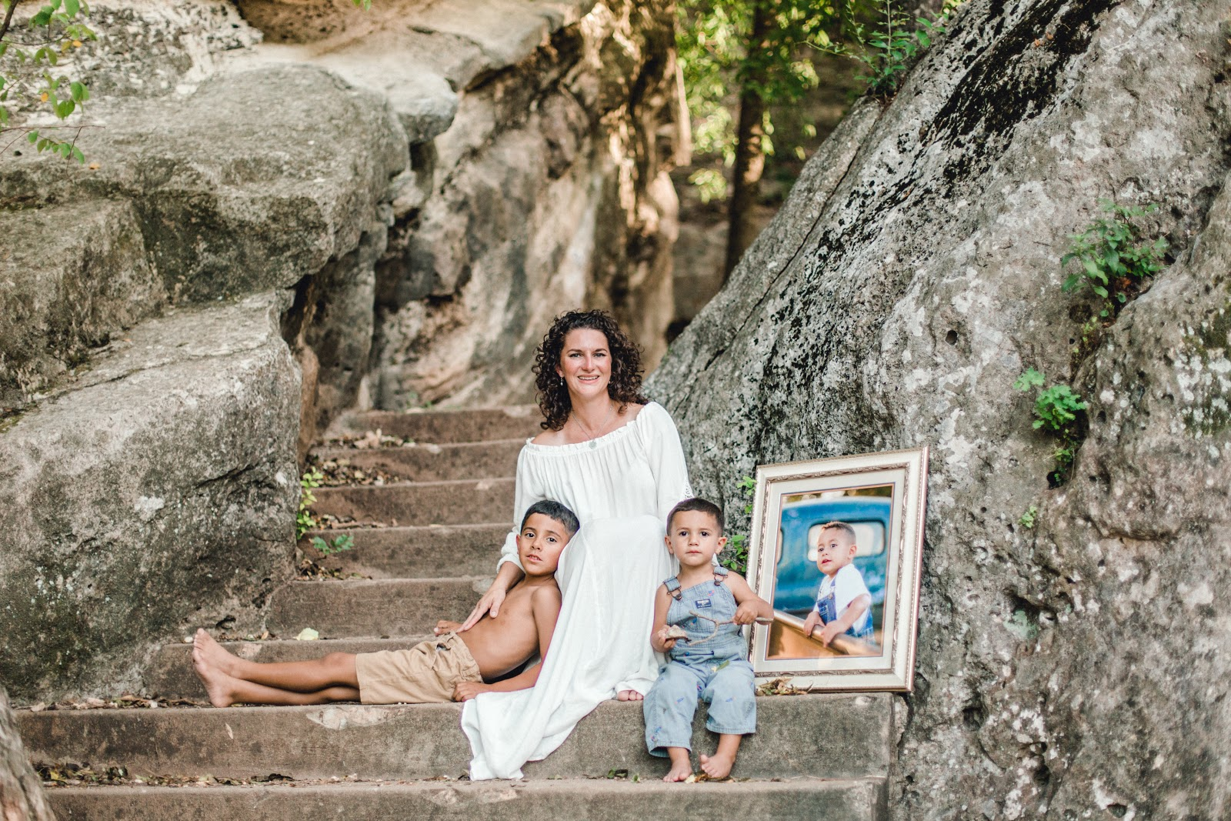
https://www.theplayfulchild.org/registration

Slide 4
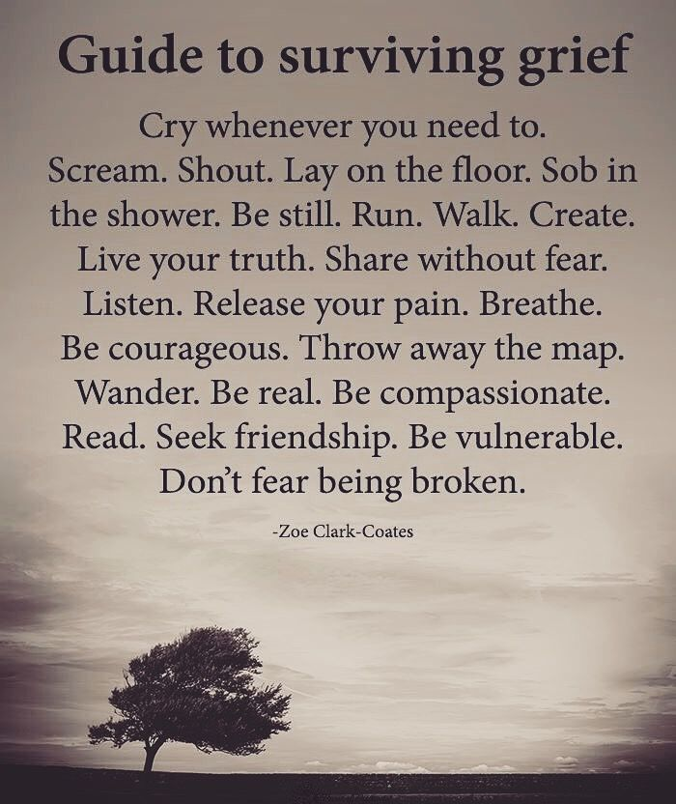

Slide 5



The Compassionate Friends Credo
We need not walk alone. We are The Compassionate Friends. We reach out to each other with love, with understanding, and with hope.
The children we mourn have died at all ages and from many different causes but our love for them unites us. Your pain becomes my pain, just as your hope becomes my hope.
We come together from all walks of life, from many different circumstances. We are a unique family because we represent many races, creeds, and relationships. We are young, and we are old. Some of us are far along in our grief, but others still feel a grief so fresh and intensely painful that they feel helpless and see no hope.
Some of us have found our faith to be a source of strength, while some of us are struggling to find answers. Some of us are angry, filled with guilt or in deep depression, while others radiate an inner peace. But whatever pain we bring to this gathering of The Compassionate Friends, it is pain we will share, just as we share with each other our love for the children who have died.
TCF Brushy Creek
Steering Committee
Co-Leaders:
Committee Members:
Robin Cassens
Caty Craig, Sibling Rep.
Stephanie Thomsen, Sibling Rep.
Mary Delaney
Vickey Harrison
Penny Leone
Rebecca Burgman-Advisory
Shelley Ransom-Newsletter
TCF National Office Information:
The Compassionate Friends
PO Box 3696
Oak Brook, IL 60522 (or)
900 Jorie Blvd. Suite 78
Oak Brook, IL 60523
Phone (630) 990-0010
Toll-Free (877) 969-0010
www.compassionatefriends.org
Email Address:
TCFBrushyCreek@gmail.com
The Compassionate Friends of Brushy Creek

